Slide 1


PS ID SIH1505 PS NAME Aerial Location of Hazardous Atmosphere in Industries (Ministry of Home Affairs)

Slide 2
Introduction
Increase in industrial fires poses a serious threat.
Resultant economic losses demand proactive measures.
Critical need for a robust Fire Pre-Plan in industries.
Recent incidents (e.g., IOCL Jaipur fire) highlight the urgency.
Over 60 lives lost daily in India due to fires (National Crime Records Bureau).
Our solution aims to address these challenges effectively.

Slide 3
Flammable Gases
Toxic Gases
Sr.No | GAS | FORMULA
1] | Hydrogen | H₂
2] | Methane | CH₄
3] | Ethane | C₂H₆
4] | Propane | C₃H₈
5] | Butane | C₄H₁₀
6] | Acetylene | C₂H₂
7] | Propylene | C₃H₆
8] | Butadiene | C₄H₆
9] | Ethylene | C₂H₄
10] | Natural Gas | Primarily CH₄ with small amounts of other hydrocarbons
Sr.No | Gas | Formula
1] | Carbon Monoxide | CO
2] | Ammonia | NH₃
3] | Chlorine | Cl₂
4] | Hydrogen Sulfide | H₂S
5] | Sulfur Dioxide | SO₂
6] | Nitrogen Dioxide | NO₂
7] | Phosgene | COCl₂
8] | Hydrogen Cyanide | HCN
9] | Ozone | O₃
10] | Formaldehyde | CH₂O

Slide 4
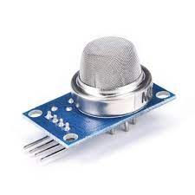
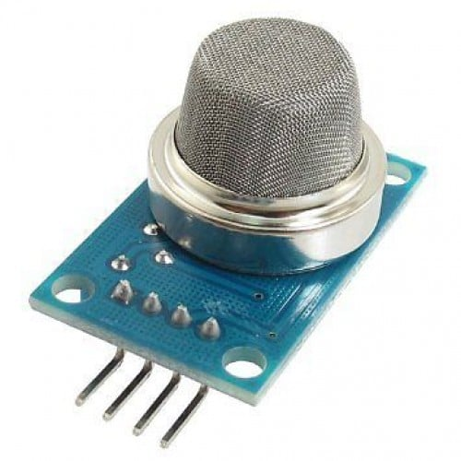
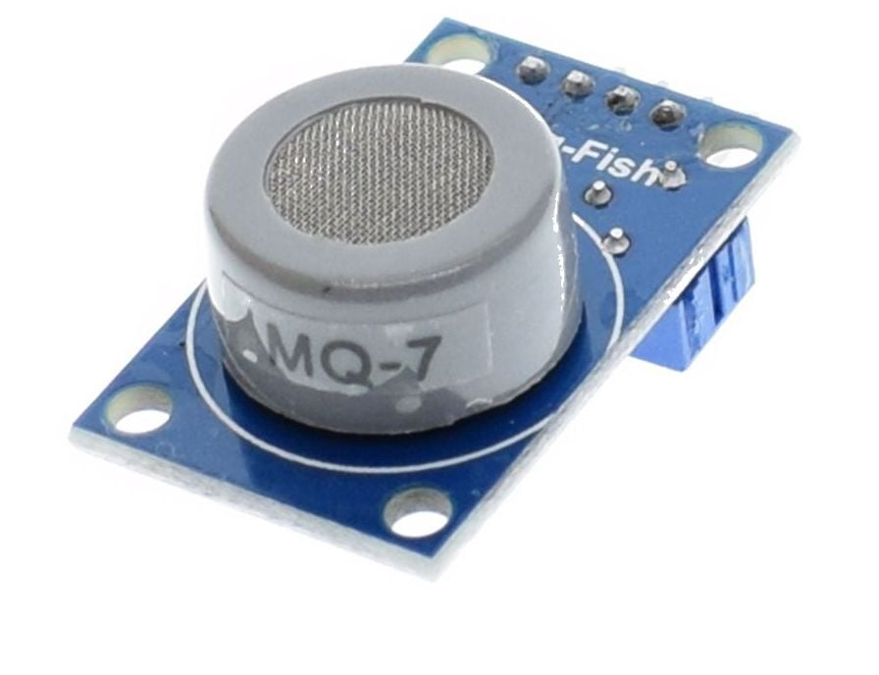
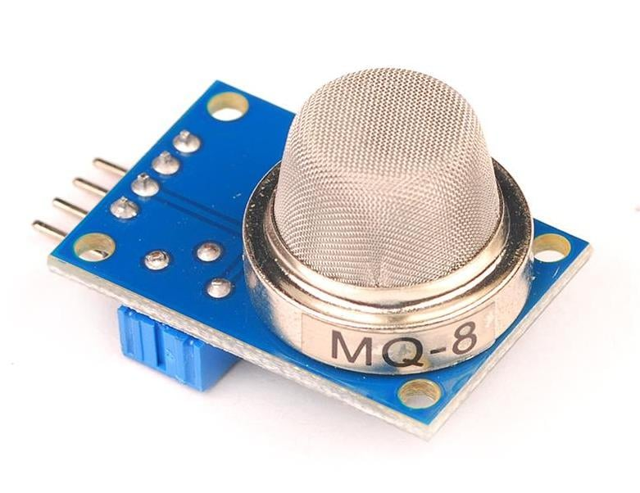
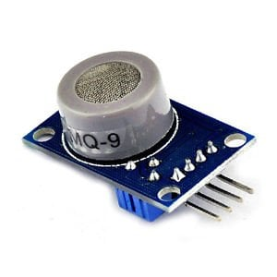
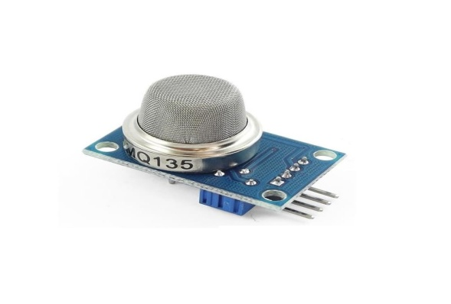
Gas Sensors Detection and Identification
MQ-3
MQ-4
MQ-7
MQ-8
MQ-9
MQ-135

Slide 5
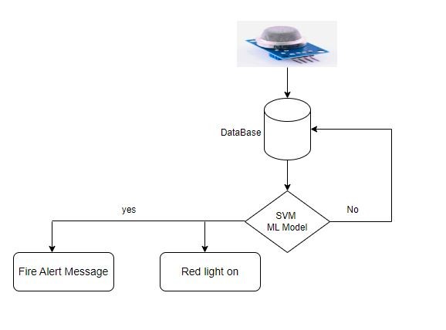
Fire Prediction Model
MQ-3 (Alcohol Sensor)(mg/L) : [25.18]
MQ-4 (Methane Sensor)(ppm) : [300.01]
MQ-7 (CO Sensor)(ppm) : [25.10]
MQ-8 (Hydrogen Sensor)(ppm) : [210.00]
MQ-9 (CO Sensor)(ppm) : [205.67]
MQ-135 (Air Quality Sensor)(ppm) : [300.80]

Slide 6
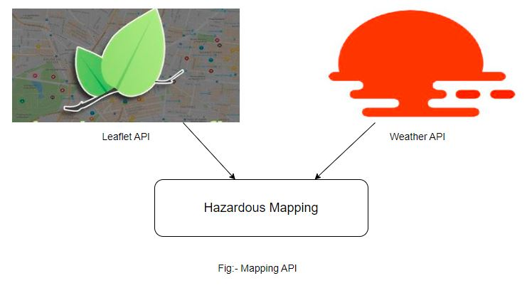
Hazardous Mapping

Slide 7
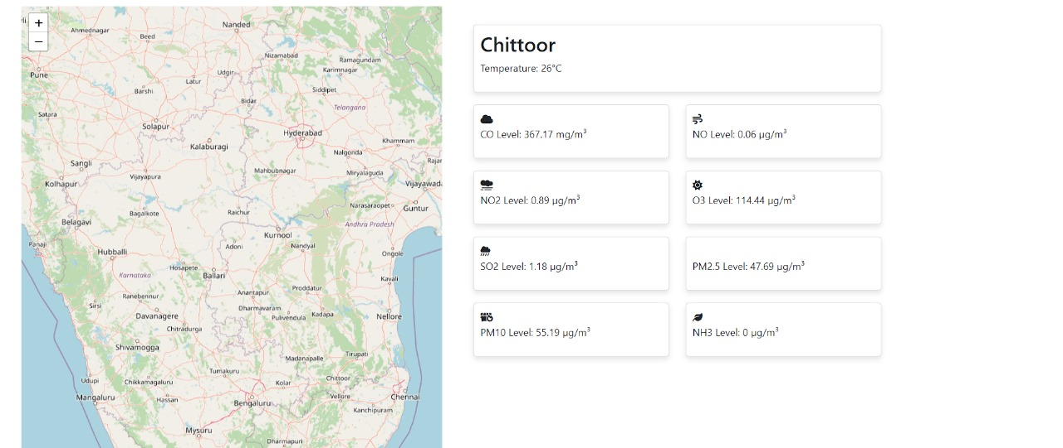
Mapping Page

Slide 8
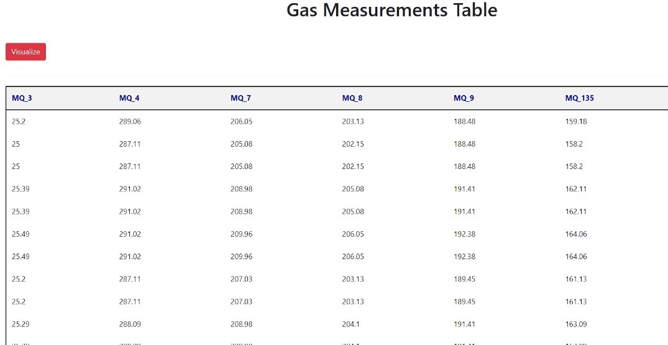
Historical Database

Slide 9
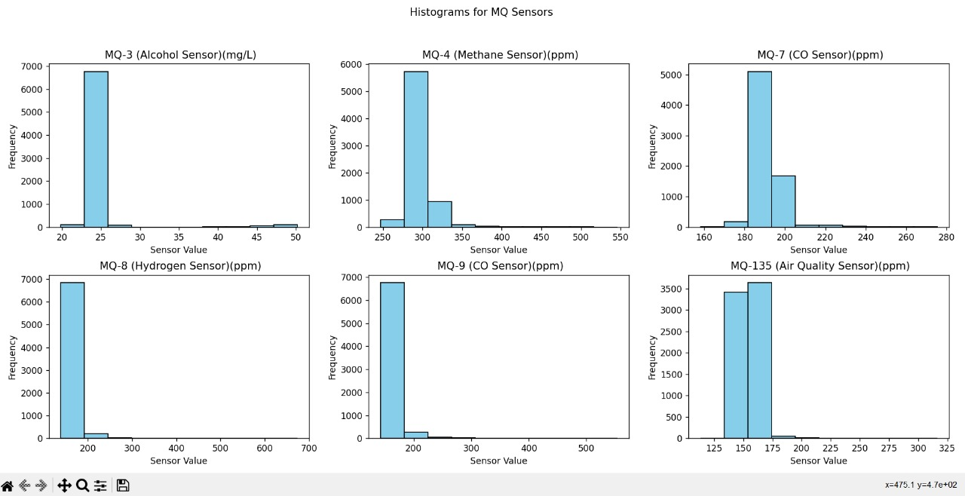
Historical Data - Visualization

Slide 10
Training and Awareness
Training and awareness is a support process that ensures user have the knowledge necessary regarding the fire hazards which includes:-
Assessing the possible risks that can cause a fire hazard and taking appropriate steps to prevent and minimize the damage cause due to a fire by providing online training
Always checking and monitor the status of equipment
Avoid Careless Smoking
Everyone Should know how to use fire extinguisher

Slide 11
Emergency Plan
Know Where to Go:
Identify the nearest exits or safe spots in your surroundings.
Practice getting to these places quickly and safely.
Stay Connected:
Have a simple plan for communicating with family or friends during emergencies.
Share important contact details and decide on a meeting place.
Pack the Basics:
Keep a small bag with water, snacks, and basic supplies.
Update it every now and then and store it where you can grab it quickly.

Slide 12
Notifications
Quick Info, Quick Action:
Notifications should tell you what you need to know in a glance.
Make it easy to understand and act on.
Sounds or Signs You Get:
Use sounds or symbols that make sense to you.
Make sure it's something you'll notice right away.
You're in Control:
Choose what notifications you want.
Keep it simple, so you only get what's important to you.

Slide 13
Feature Scope
Automated Machinery Shutdown
Smart Sprinkler System with Fire Prediction
Visual Indicators
Real-time Communication
Mobile Alert Integration
Continuous Alerts

Slide 14
References
Fire prevention in industrial environments:
https://link.springer.com/chapter/10.1007/3-540-45420-9_22
https://ieeexplore.ieee.org/abstract/document/8076375
https://onepetro.org/SPEATCE/proceedings/07ATCE/All-07ATCE/SPE-110521-MS/143107
MQ series sensor:
http://telkomnika.uad.ac.id/index.php/TELKOMNIKA/article/view/17427
https://huskiecommons.lib.niu.edu/studentengagement-honorscapstones/279/

Slide 15
Team Member Details
Team Leader Name : Mr. Rahul Sanjay Tetwar Branch : MCA Stream : Computer Science Year : II
Team Member 1 Name : Ms. Akankasha Atul Kasar Branch : MCA Stream : Computer Science Year : II
Team Member 2 Name : Mr. Pranjal Shankar Jadhav Branch : MCA Stream : Computer Science Year : II
Team Member 3 Name : Mr. Prajwal Mohan Chapke Branch : MCA Stream : Computer Science Year : II
Team Member 4 Name : Mr. Govind Madan Ambade Branch : MCA Stream : Computer Science Year : II
Team Member 5 Name : Mr. Vedant Vivek Koleshwar Branch : MCA Stream : Computer Science Year : II
Team Mentor 1 Name : Dr. Shubhashree Savant
Category : Academic Expertise : Medical Image Processing , AI and Programming Domain Experience : 10years

Slide 16
THANK YOU ..!!!

